Slide 1
SIMPLE INTEREST
With simple interest, the amount of interest for equal time periods is the same. This is because the principal remains the same. This is the case with Interest Bearing Deposits (IBDs) – the interest at the end of each time period is paid into a different account so that the principal always remains the same.
The formula for simple interest is given by
I = P × R × T or I = PRT
where I is the simple interest,
P is the principal (amount of money invested),
R is the rate of interest (expressed as a decimal)
T is the time of the investment
NOTE The time arguments for R and T must agree i.e. if the time is expressed in years, then the rate of interest should be expressed as a rate per year (annum)
Example 1 Find the simple interest on $5 000 for 3 years at 7.6% p.a.
Solution I = PRT
= $5 000 × 0.076 × 3 [7.6% = 0.076]
= $1 140
Example 2 Find the simple interest on $800 for 21 months at 6.8% p.a.
Solution I = PRT
= $800 × 0.068 × [Time arguments should agree –
= $95.20 divide by 12 to change months to years]

Slide 2
Example 3 For how long should $640 be invested at 7.5% SI to earn $144?
Solution I = PRT
144 = 640 × 0.075 × T
144 = 48T
T = 144 ÷ 48 = 3
Hence should invest for 3 years
Example 4 At what simple interest rate should $4 000 be invested to grow to
$5 360 in 4 years?
Solution Interest = final amount – initial amount
= $5 360 - $4 000
= $1 360
I = PRT
1 360 = 4 000 × R × 4
1 360 = 16 000R
R = = 0.085
Hence the rate should be 8.5%

Slide 3
COMPOUND INTEREST
In compound interest, the interest from one time period is added to the principal. This means that this interest gains interest the next time period. Hence the interest will increase from one time period to the next. Ex 1 Consider $6000 invested ar 10% compound interest for 3 years, with the interest compounded annually. Interest first year = $6000 × 0.10 = $600
Hence amount at end of year = $6600 This becomes the principal for the second year. Interest second year = $6600 × 0.10 = $660 Hence amount at end of second year = $7260 This becomes the principal for the third year.
Interest third year = $7260 × 0.10 = $726 Hence amount at end of third year = $7986
So interest for the three years is $1986 (either $7986 - $6000 OR $600 + $660 + $726)
This can be done in one step if you use the formula Amount = P × (1 + r)^{n}
where P is the principal,
r is the rate (as a decimal) for the time period and n is the number of times the interest is compounded during the investment e.g. for the above example, P = $6000, r = 0.10 and t = 3 Hence Amount = $6000 × (1.1)³
= $7986 as above

Slide 4
Consider now the same amount of money as above, invested for 3 years as above, but compounded every 6 months instead of every year.
Now p = $6000, r = 0.05 (10% for one year is the same as 5% for 6 months), n = 6 (there are 6 lots of 6 months in 3 years) Now amount = P × (1 + r)^{n} = $6000 × (1.05)⁶
= $8040.57 Note how the interest has increased by compounding more often. Now consider 3-monthly compounding amount = P × (1 + r)^{n} = $6000× (1.025)¹² = $8069.33 Note how this is even more interest.
Now finish Ex 3A questions 1 – 13 from your textbook

Slide 5
FINANCIAL CALCULATIONS
Interest
The price paid for borrowing money. It is expressed as a percentage rate over a period of time.
Principal
The total amount of money being borrowed or lent.
Simple interest
Interest calculated as a simple percentage of the original principal amount.
Compound interest
Interest paid on previously earned interest as well as on the principal.
Future Value - FV
The value of an asset or cash at a specified date in the future that is equivalent in value to a specified sum today. There are two ways to calculate FV:
a) For an asset with simple annual interest:
$1000 invested for 5 years with simple annual interest of 10% would have a future value of $1,500.00.
b) For an asset with interest compounded annually:
$1000 invested for 5 years at 10%, compounded annually has a future value of $1,610.51.
Present Value - PV
The amount of cash today that is equivalent in value to a payment, or to a stream of payments, to be received in the future.

Slide 6
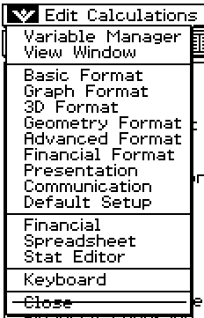
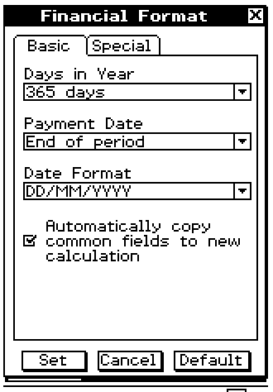
NOTE
Set your calculator using “Financial Format” to correctly calculate with the data that you use.

Slide 7
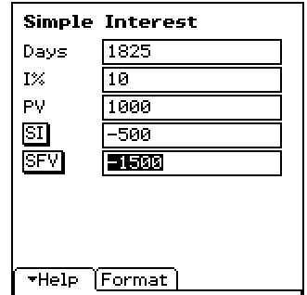
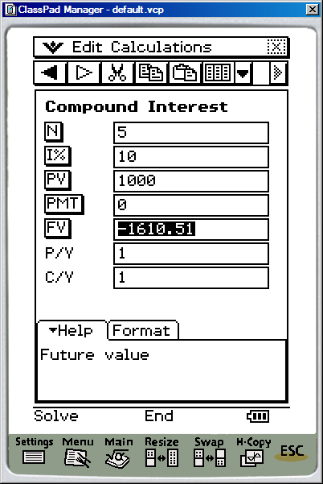
SIMPLE INTEREST
Convert the number years to days
The interest rate as a percentage
PRINCIPAL
SIMPLE INTEREST
PRINCIPAL + INTEREST
Make sure that the setting is 1 YEAR = 365 DAYS
COMPOUND INTEREST
Number of years
The interest rate as a percentage
PRINCIPAL
The amount owing after n years
PRINCIPAL + INTEREST

Slide 8
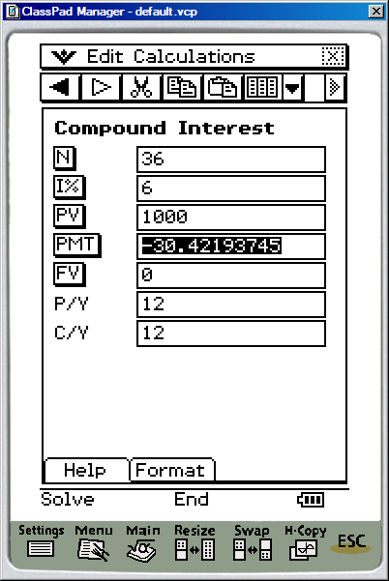
EXAMPLE
Find the monthly repayments if $1000 is borrowed for 3 years at 6% p.a. reducible monthly?
SOLUTION
N 3 x 12 = 36 because the payments are monthly.
I% 6
PV $1000 PMT what is needed to be found FV the future value needs to be zero because the loan has been repaid. P/Y 12 because the payments are monthly
C/Y 12, because the interest is added monthly.
ANSWER $30.42 needs to be paid each month.

Slide 9
Example 2. Billy-Jo gets into trouble with her credit card and has it cancelled with a total of $800 owing on it. She agrees to pay it off at 2% per month reducible interest and payments of $75 at the end of each month. How much does she still owe after 6 months?
Solution 100% + 2% = 102% = 1.02
Amount end 1st month = $800 × 1.02 - $75 = $741
Amount end 2nd month = $741 × 1.02 - $75 = $680.82
Amount end 3rd month = $680.82 × 1.02 - $75 = $619.44
Amount end 4th month = $619.44 × 1.02 - $75 = $556.83
Amount end 5th month = $556.83 × 1.02 - $75 = $492.96
Amount end 6th month = $492.96 × 1.02 - $75 = $427.82
Hence she still owes $427.82 after 6 months. Note: This can be done on your CAS calculator under
financial compound interest with
N: 6 I% 24
PV: 800
PMT: -75
FV:
P/Y: 12
C/Y: 12
Then tap on FV: The answer will show -427.8208632 .

Slide 10
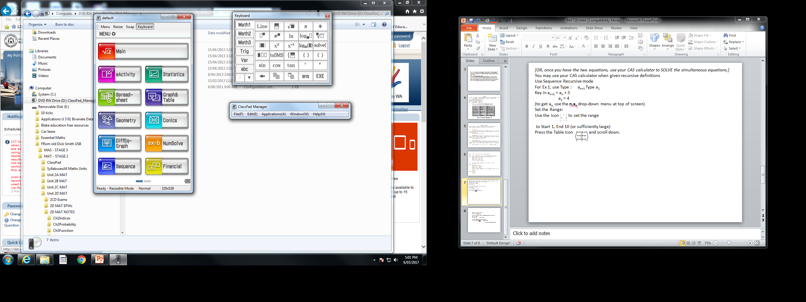
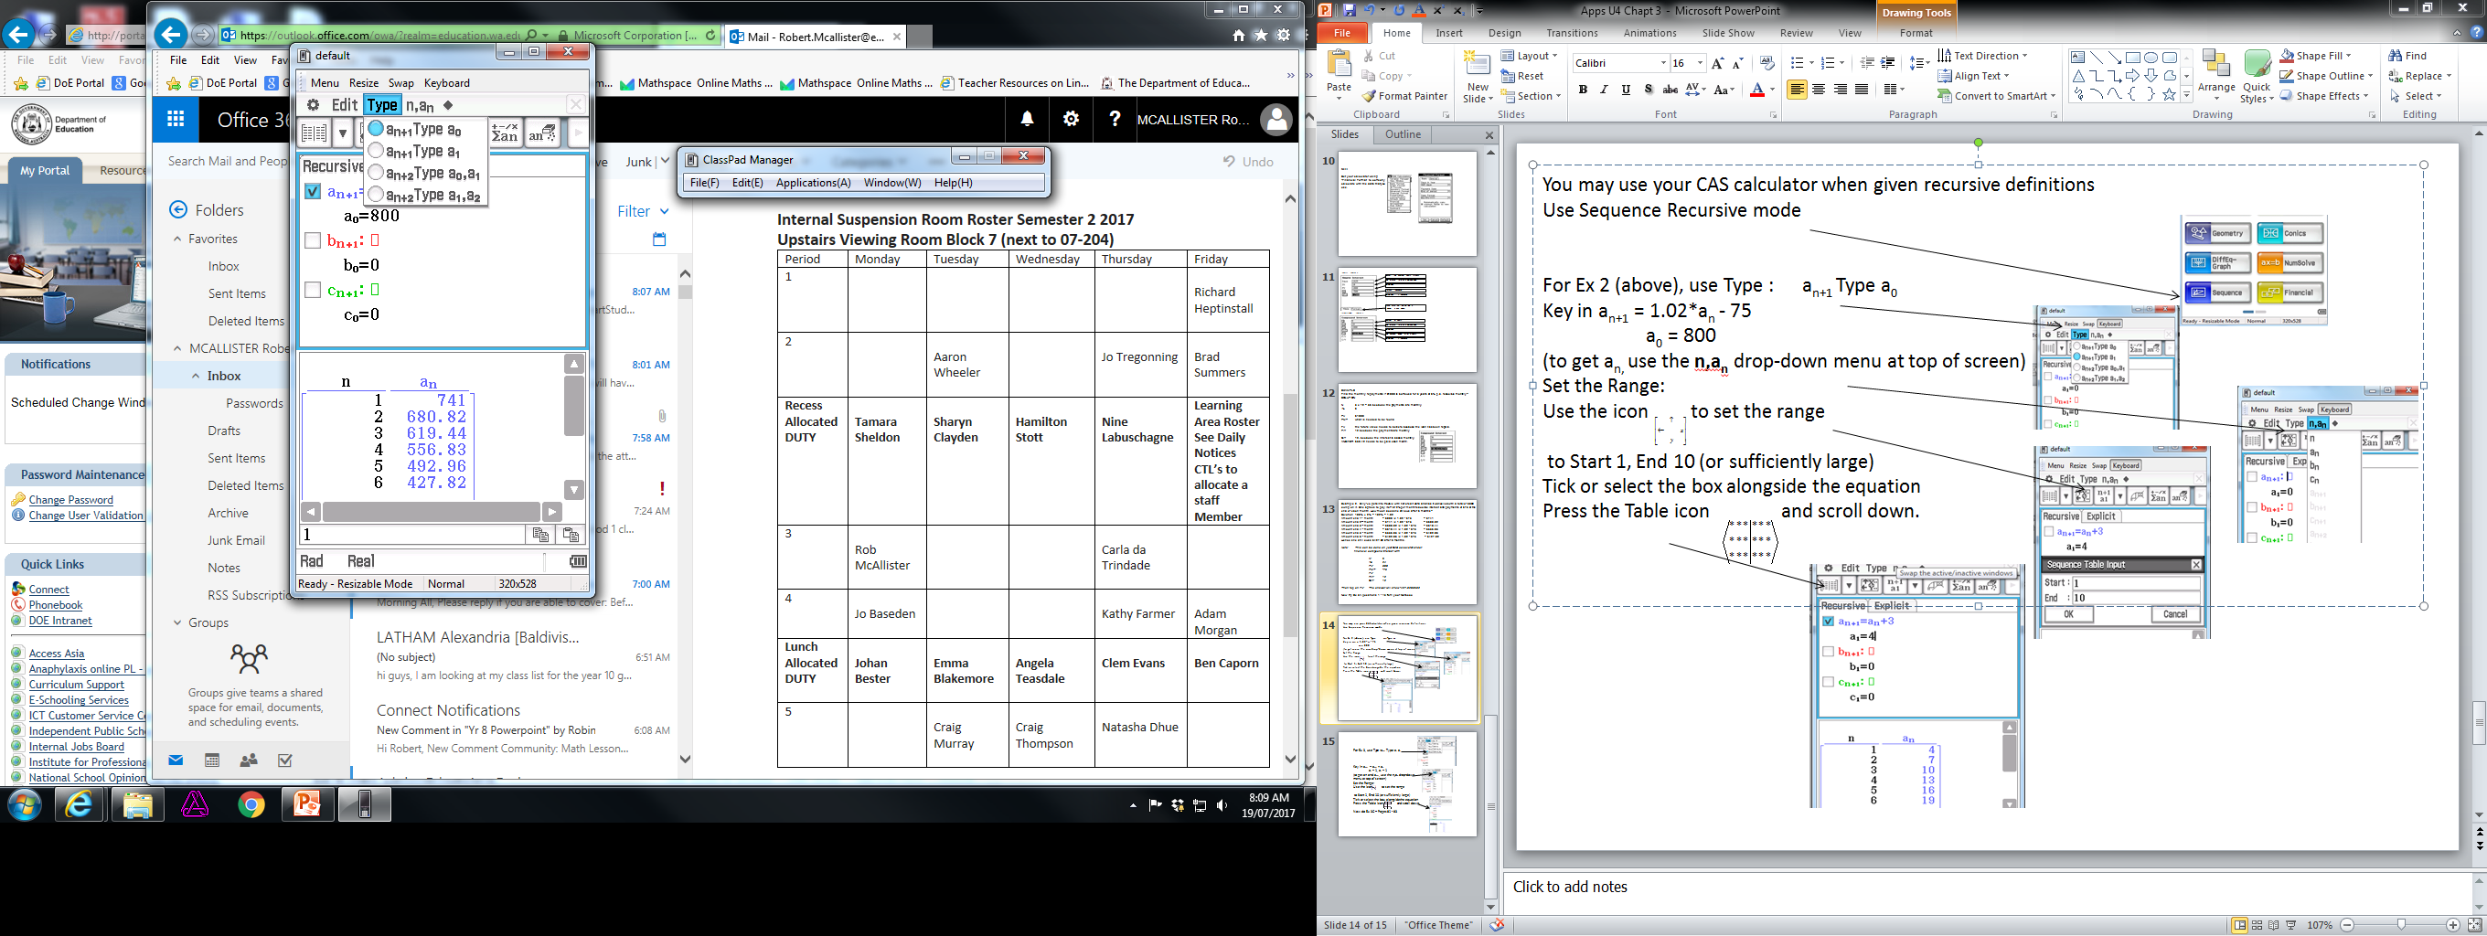
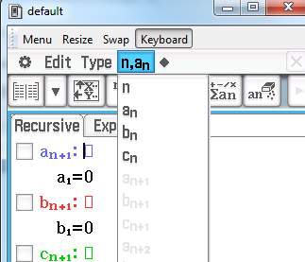
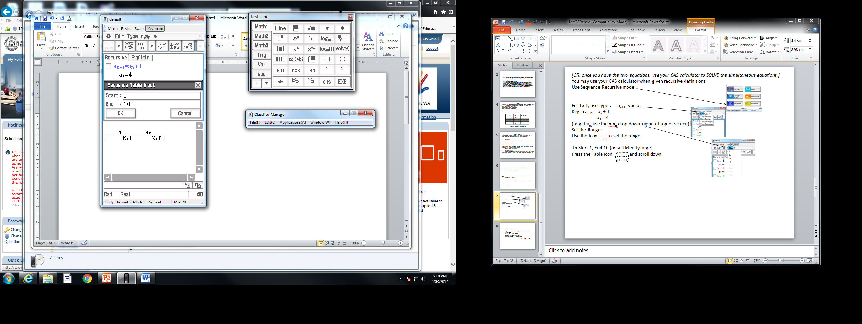
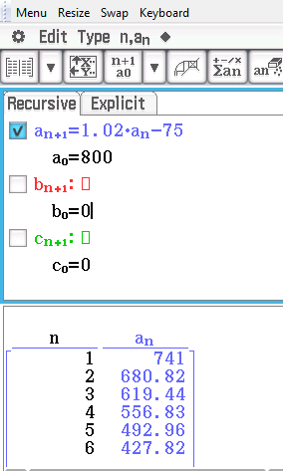
You may use your CAS calculator when given recursive definitions
Use Sequence Recursive mode
For Ex 2 (above), use Type : a_{n+1} Type a₀ Key in a_{n+1} = 1.02*a_{n} - 75
a₀ = 800
(to get a_{n,} use the n,a_{n} drop-down menu at top of screen) Set the Range: Use the icon to set the range
to Start 1, End 10 (or sufficiently large) Tick or select the box alongside the equation
Press the Table icon and scroll down.
Note: term a₀ is for the start of time therefore term a₁ is at the end of the first month etc
Now finish off exercise 3A questions 14 – 30 from your text books

Slide 11
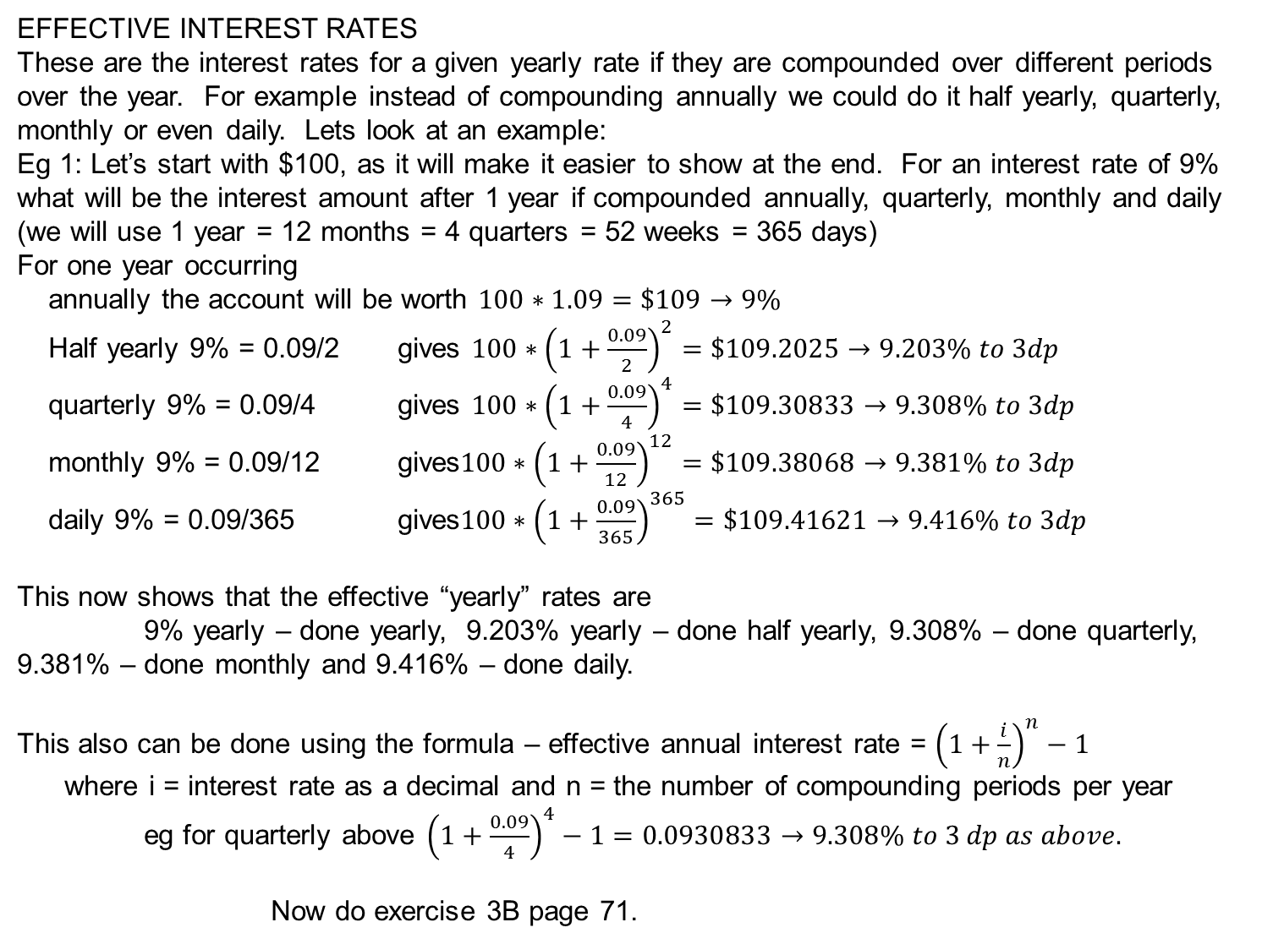
EFFECTIVE INTEREST RATES
These are the interest rates for a given yearly rate if they are compounded over different periods over the year. For example instead of compounding annually we could do it half yearly, quarterly, monthly or even daily. Lets look at an example:
Eg 1: Let’s start with $100, as it will make it easier to show at the end. For an interest rate of 9% what will be the interest amount after 1 year if compounded annually, quarterly, monthly and daily (we will use 1 year = 12 months = 4 quarters = 52 weeks = 365 days)
For one year occurring
annually the account will be worth $100∗1.09=\$109→9\%$
Half yearly 9% = 0.09/2 gives $100∗{\left(1+\frac{0.09}{2}\right)}^{2}=\$109.2025→9.203\% to 3dp$
quarterly 9% = 0.09/4 gives $100∗{\left(1+\frac{0.09}{4}\right)}^{4}=\$109.30833→9.308\% to 3dp$
monthly 9% = 0.09/12 gives$100∗{\left(1+\frac{0.09}{12}\right)}^{12}=\$109.38068→9.381\% to 3dp$
daily 9% = 0.09/365 gives$100∗{\left(1+\frac{0.09}{365}\right)}^{365}=\$109.41621→9.416\% to 3dp$
This now shows that the effective “yearly” rates are 9% yearly – done yearly, 9.203% yearly – done half yearly, 9.308% – done quarterly, 9.381% – done monthly and 9.416% – done daily.
This also can be done using the formula – effective annual interest rate = ${\left(1+\frac{i}{n}\right)}^{n}−1$
where i = interest rate as a decimal and n = the number of compounding periods per year
eg for quarterly above ${\left(1+\frac{0.09}{4}\right)}^{4}−1=0.0930833→9.308\% to 3 dp as above.$
Now do exercise 3B page 71.

Slide 12
INVESTMENT ACCOUNTS
Ex: Rheanon opens an investment account following advice from her financial manager. She initially deposits $10 000 in the account which pays 6% pa interest, with the interest accruing monthly. In addition, she agrees to deposit $500 into the account at the end of each month. How much is the investment worth on the completion of 6 months?
Solution: Since the rate is 6% pa, this is equivalent to 0.5% per month [6 ÷ 12 =0.5]. Hence the multiplier factor for each month is 1 + 0.5% = 1 + 0.005 = 1.005
NOTE Had she not been receiving interest, her account would have held $13 000 ($10 000 initial deposit + 6 lots of $500)
Hence she has gained $341.52 in interest in these 6 months.
Month | Principal at beginning | Calculation of amount at end | Amount at end
1 | $10 000 | $10 000 × 1.005 + $500 | $10 550
2 | $10 550 | $10 550 × 1.005 + $500 | $11 102.75
3 | $11 102.75 | $11 102.75 × 1.005 + $500 | $11 658.26
4 | $11 658.26 | $11 658.26 × 1.005 + $500 | $12 216.55
5 | $12 216.55 | $12 216.55 × 1.005 + $500 | $12 777.63
6 | $12 777.63 | $12 777.63 × 1.005 + $500 | $13 341.52

Slide 13
Note: This can be done on your CAS calculator under
financial
compound interest
with N: 6 Number of interest periods I% 6 Interest rate p.a.
PV: 10 000 Present Value = principal
PMT: 500 PayMenT = amount deposited each month
FV: Future Value = final amount after 6 months
P/Y: 12 number of Payments/Year
C/Y: 12 number of times interest is Compounded/Year
Then tap on FV: The calculator will show -13341.52603 This means the investment is now worth $13 341.53
Now find the final amount after 6 months in a similar investment account if Bruce invests $6 000 at 7.2% pa with monthly deposits of $400. Use both Sequences and Financial Apps
[$8 655.56]
If you are doing a Reducible interest problem, put the payment in as a negative amount. If you wish to pay off a loan under reducible interest, put FV = 0 (meaning the loan is paid off) Then tap on PMT to find the amount of each payment to clear the loan in the given time.

Slide 14
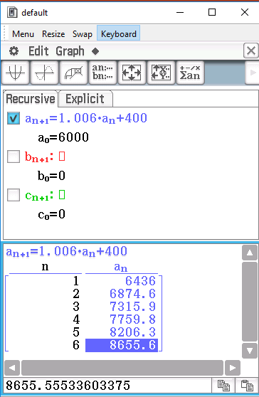
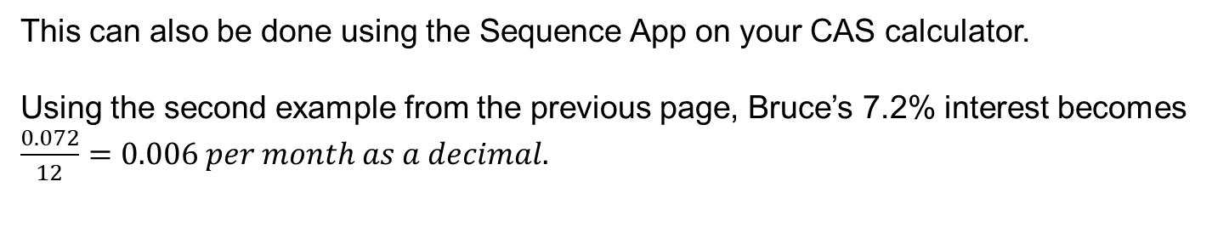
This can also be done using the Sequence App on your CAS calculator.
Using the second example from the previous page, Bruce’s 7.2% interest becomes $\frac{0.072}{12}=0.006 per month as a decimal.$
Don’t forget to set it up to use the a₀ as 6000 and then you will have n=6 as the 6th month
This gives the same answer as the previous page but rounded to $8655.60.
If you want the more accurate answer highlight term 6 and look at the answer on the line below.
This gives $8655.56
Rounded to 2dp – nearest cent.
Now do exercise 3C page 75.

Slide 15
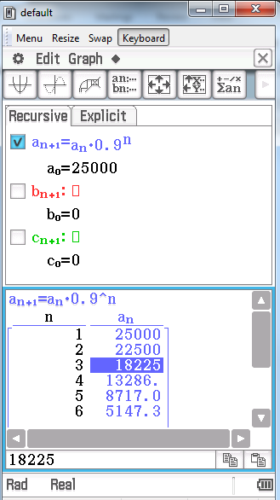
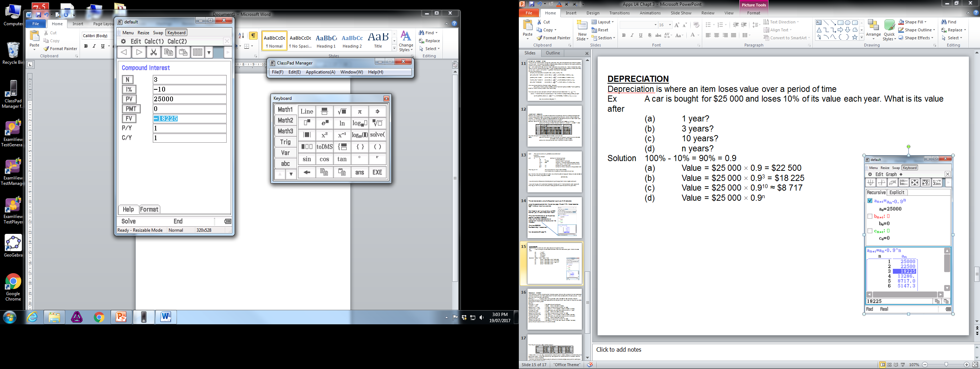
DEPRECIATION Depreciation is where an item loses value over a period of time Ex. A car is bought for $25 000 and loses 10% of its value each year.
What is its value after
(a) 1 year? (b) 3 years? (c) 10 years?
(d) n years?
Using the Sequence App for 3 years – don’t forget to use the a₀ one so that it is n = 3 for the third year.
Solution 100% - 10% = 90% = 0.9 (a) Value = $25 000 × 0.9 = $22 500 (b) Value = $25 000 × 0.9³ = $18 225 (c) Value = $25 000 × 0.9¹⁰ ≈ $8 717
(d) Value = $25 000 × 0.9^{n}
Using the Financial Maths App for 3 years – put the info in and press FV (Future Value).
Note the interest is -10% as it is depreciating.

Slide 16
REDUCIBLE INTEREST or LOANS WITH REGULAR PAYMENTS
With reducible interest, the amount of interest you pay from one time period to the next decreases (reduces) because you make payments off the loan which decreases the amount you owe. If you owe less, then you pay less interest.
Example 1. A couple take out a personal loan of $6 000 at 10% reducible interest, calculated annually. They make repayments of $150 per month. How much will they still owe on the completion of three years?
Solution
Principal 1st year = $6 000 (amount borrowed)
Interest 1st year = $600 (10% of $6 000 is $600)
Repayment 1st year = $1 800 (12 payments of $150 = $1 800)
Amount end 1st year = $4 800 (P + I – R = $6000 + $600 - $1800 = $4800)
Principal 2nd year = $4 800 (same as what was owed at end of 1st year)
Interest 2nd year = $480 (10% of $4 800 is $480)
Repayment 2nd year = $1 800 (12 payments of $150 = $1 800)
Amount end 2nd year = $3 480 (P + I – R = $4800 + $480 - $1800 = $3480)
Principal 3rd year = $3 480 (same as what was owed at end of 2nd year)
Interest 3rd year = $348 (10% of $63480 is $348)
Repayment 3rd year = $1 800 (12 payments of $150 = $1 800)
Amount end 3rd year = $2 028 (P + I – R = $3 480 + $348 - $1800 = $2 028)
Hence amount owed at end of 3rd year is $2 028

Slide 17
This may be set out in table form or spreadsheet as follows:-
In table form, it is very easy to calculate the total amount of interest charged or the total amount of payments made. It may also be seen, by looking down the interest column in the table, that the interest is indeed reducing.
If you are not concerned about seeing the amount of interest charged each year, this setting out may be further abbreviated:-
Multiplier rate = 100% + 10% = 110% = 1.1
Amount end 1st year = $6 000 × 1.1 - $1 800 = $4 800
Amount end 2nd year = $4 800 × 1.1 - $1 800 = $3 480
Amount end 3rd year = $3 480 × 1.1 - $1 800 = $2 028
Let’s now look at how we can work using the Financial and Sequence Apps on your CAS calculator.
Year | Amt begin | Interest | Repayment | Amt end
1 | $6 000 | $600 | $1 800 | $4 800
2 | $4 800 | $480 | $1 800 | $3 480
3 | $3 480 | $348 | $1 800 | $2 028
Totals | ######## | $1 428 | $5 400 | ########

Slide 18
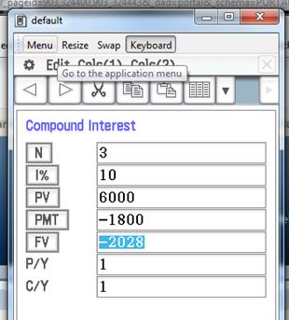
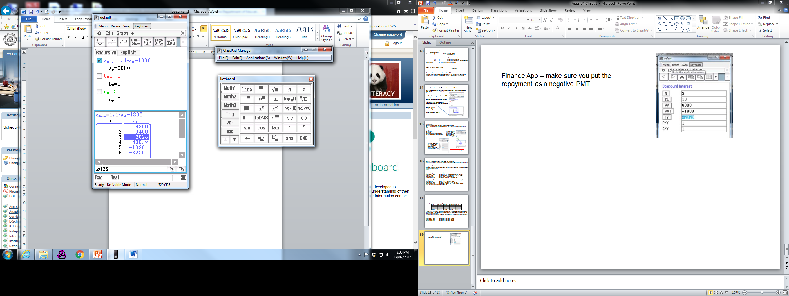
Finance App – make sure you put the repayment as a negative (PMT), also note that the Future Value (FV) is negative because that is the amount that you still owe.
Sequence App – the interest is 1.1 as in 110% and then take the $1800.
Same as before use the a₀ so the n is the year with what they owe.
Now do exercise 3E page 79 - 81.

Slide 19
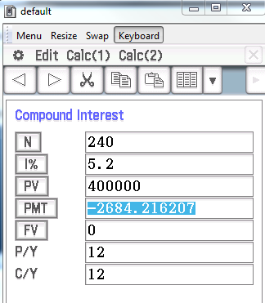
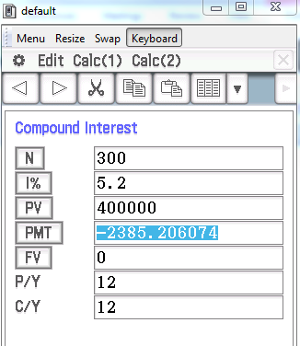
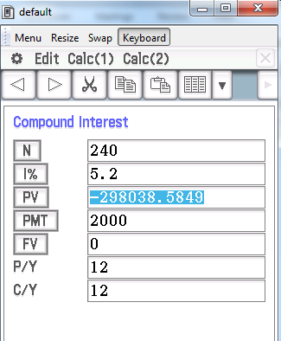
How much can you afford to borrow for your new house
I would like to borrow $400 000 for a house I want to buy – can I afford to pay for it if I can afford $2000 per month ($500 per week) and want to pay it off over 20 years and interest is 5.2%pa.
20 years = 240 months
The answer is no as I would need to pay $2684.22 per month
What about over 25 yrs?.
– still no as I need $2385.21 per month.
So what can I afford to borrow paying about $2000 per month over 20 years?
The PV is about $300 000 so that is all I can afford to borrow.
Now do exercise 3F page 84 and the Miscellaneous Exercise 3 pages 84 - 86.

